Slide 1

Website Development Project: PrakaTechFusion
Discover our new lead-generating, brand-focused website for PrakaTechFusion, a digital marketing agency. Built on WordPress using Astra and Elementor for speed and responsiveness.
Presented by Abubakkar Siddiq
Visit: https://prakatechfusion.infy.uk

Slide 2

Project Overview
Goal
Platform
Create a lead-generating, brand-focused website.
WordPress with Astra theme and Elementor builder.
Objective
Drive engagement, boost brand visibility, and increase client conversions.

Slide 3

Brand Vision
Innovative Strategies
Business Growth
We specialize in digital marketing innovation.
Empowering brands through digital transformation.
ROI Focused
We prioritize engagement, identity, and measurable results.

Slide 4





Our Services
Design
Development
Marketing
Visually stunning, user-friendly designs.
Seamless performance and user experience.
SEO, PPC, Email, and Content campaigns.
Social Media
Platform-specific engagement strategies.

Slide 5

eCommerce & Support
eCommerce
Support
Websites optimized for conversion and sales.
Reliable, dedicated customer service for every client.
Continuous Improvement
Ongoing updates and proactive solutions.

Slide 6



Website Structure
Additional Sections
Main Pages
Our Customers
2
Meet the Team
Home
Footer with contact & links
About
1
Services
Portfolio
3
CTAs
Contact
Get Started
Let’s Talk

Slide 7
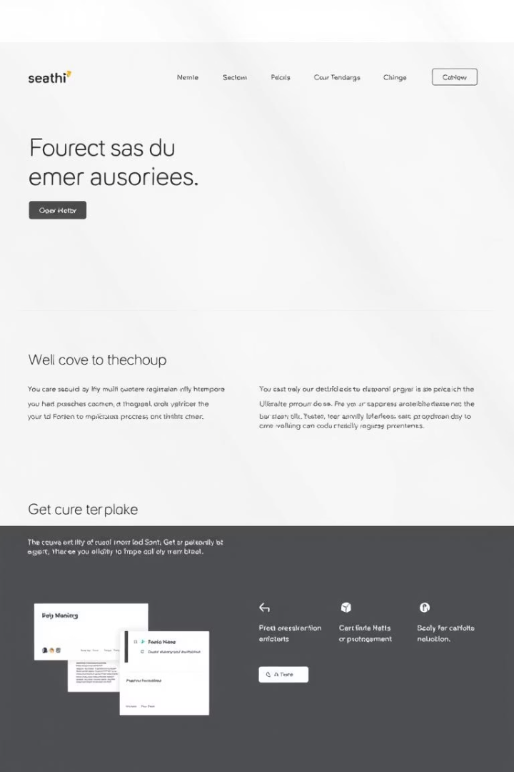
Design & UX Approach
1
Theme & Builder
Astra theme and Elementor builder for flexibility.
2
UI/UX Focus
Clean layout, fast loading, and responsive design.
3
Visual Identity
Professional color palette and modern typography.

Slide 8

Live Website Demo
Let’s explore the live site: 🔗 https://prakatechfusion.infy.uk (Click-through and walkthrough demo recommended)

